Slide 1
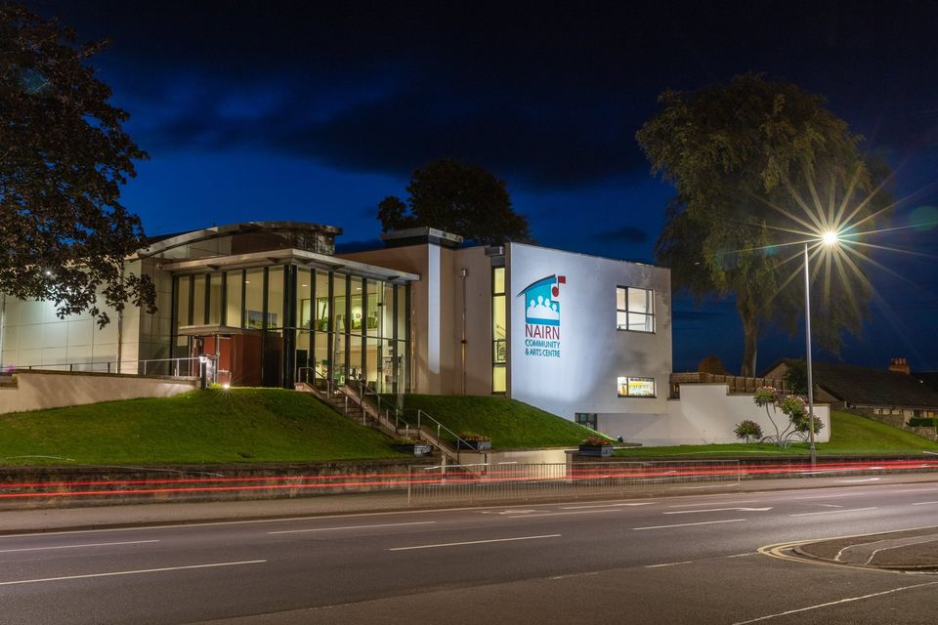

Our Journey
Our Future

Slide 2

Nairn Community and Arts Centre
Our Journey
Built 17 years ago with support and funding from several organisations, including the Nairn community.
The Building is currently owned by Highland Council and run and operated as a Scottish registered charity by a volunteer Board of Directors.
25 Year lease. The lease devolves all care and maintenance to the Board of Directors.
Highland Council, in agreement with the Board of Directors committed to a 25-year subsidy package of £1.3m to support the financial operating model during the term of the lease.
Highland Council terminated this subsidy in 2018 (total received £657,374). No further funding or support has been provided.
This in essence this left the Directors with a massive operating shortfall. This shortfall over the years was supported by our reserve funds and one-off grants from various funders.
Covid provided its own challenges!
Home for over 52 community groups and charities.
Accommodates several small community businesses and a nursery.
Home for several small churches.
Home for the Nairn Book and Arts Festival, Nairn Ceilidh, Cinema Nairn, Music Nairn and Jazz Nairn
Annual footfall of over 75,000.
Hosts monthly Art Exhibitions for local artists – fully booked to 2028.
Full program of Events and Entertainment.
Run and operate Nairn Community Transport.
Dedicated staff of 9 (incl. 3 part-time) – operating a shift system to accommodate our required opening hours.
Our pricing model considers both community and commercial use.
All of this with no external funding

Slide 3
Nairn Community and Arts Centre
Securing Our Future?
Current situation
Unsuccessful with significant grant funding applications – funding organisations are being overwhelmed with applications.
We are experiencing significant increases in repair costs to the building, due to its age.
Our utilities have more than doubled in cost even with savings from the Environmental Project that we implemented in 2021
Statutory salary increases
Emergency £50,000 “draw down” facility kindly provided by Nairn Common Good Fund. We have currently drawn £25,000 from this facility and will make a final request prior to the end of the month
Full operating review is in progress. Evaluating all aspects of our deliverables, costs, charges and focus areas.
We are seeing an increasing in our income that will help close the trading deficit.
Our Future
Implement the outcomes of our operational review – in progress
We have created a Sponsorship Program for local businesses or individuals – Example, 30 businesses x £1,000 = £30,000
Recruit additional Directors – HR, marketing etc.
Regular fundraising events – requires community participation.
How can you help:
  Support us at the Co-op – we are one of the local Good Causes
  Sign up as a Patron of the Centre
  Subscribe to our 50/50 club – we have a target of 500 = £15,000
  Commit to buy our “Draw Tickets” - 2000 tickets at £5 = £10,000
  Leverage your “network” of contacts to support the sponsorship program.
  A pool of volunteer to help at our events etc.,
  New ideas to create funds – do you have any?
  Grant application program – do you have experience, and could you help with this?
  Lobby your 4 Councilors and get them to support the Centre. Highland Council provide financial support (Utilities) for most organisations like ours across the region. Why not NCAC? All we are asking for is a LEVEL PLAYING FIELD.

Slide 4
Its Your Centre
We need your support!
We need Nairn Community support!
We need Nairn Businesses support!
We are making progress, but there is still lots of work to do.

